Slide 1
IngSpector Your Mobile Food Ingredient Inspector
Dogukan Karayilanoglu C0755495
Rosette Lopez Pardillo C0768425

Slide 2
Context Overview
Technical details on IngSpector Implementation
Overview
User Flow
Project Timeline, Version Control & Sprint
Project Results

Slide 3
Problem
Allergy is a person’s body damaging reaction when its immune system is hypersensitive to food or harmless substances in the environment

Slide 4
Solution
Prevention is better than cure.
Detect earlier if the food contains allergen ingredients
IngSpector – Your mobile food ingredient inspector

Slide 5
Application Features
User Register, Log In & Log Out
User Profile
Analyzing Food
List of Food the User is Allergic to
Deleting Entries
Server Data
Analyzing Allergens By Food Label
Analyzing Allergens By Food Name

Slide 6
Implementation
Two main modules:
Mobile code
Server
IOS Device
internet
Server
DB
User Defaults

Slide 7
Implementation
GIT for code version control
Code will be centralized in GitHUB
Ingspector
IOS Code
Server Code

Slide 8
Server
Server contains database implemented in MySQL that holds IngSpector user information
Provides API in order client, the IngSpector Mobile Application, to access user details
Add User
Add Allergic food to user
Add Allergen to user list
Get User Information
Get All email addresses
Get user list of allergens
Get user list of allergic food
Remove allergen from user
Update User information
User Log In

Slide 9
IngSpector Log In
First view user sees after installation
Navigates to Log In or Sign Up to Register
Skipped if user has not Logged out from previous session
UIViewController

Slide 10
IngSpector Register
View user sees when signing up
Sends data to server
Notifies user when fields are empty.
Sends new user data to server
Implemented in UIViewController

Slide 11
IngSpector Home
Home Page
First page user sees after logging in
First page user sees when opening application when user has not signed out previous session
Can traverse to User Profile Page & Food List Page
Two actions: Take Photo Label, Search by Food Name
Implemented in UIViewController

Slide 12
Analyze Food Taking Photo of Food Label
Tesseract Optical Character Recognistion (OCR) IOS engine
Neural Network Model of Machine Learning
Processing Image-to-Text and compares result with allergen List the user has
Notify user if food is safe, otherwise, prompts user Food Name so it will be saved in Food List

Slide 13
Analyze Food Search by Food Name
Recipe Puppy API in retrieving ingredients
Compares ingredients to user’s allergen list
Notifies user of allergen, otherwise, will ask user if he/she wants to know nutritional value
If so, user is prompted of food quantity and nutritional value is retrieved using Edamam API
When food contains matching allergens, it will be automatically saved in user’s Food List

Slide 14
IngSpector Food List
Displays users list of food that contains allergens user is allergic to
Edit option allows user to reorder food list
Can traverse to other pages

Slide 15
IngSpector User Profile
Displays user information
User can edit Height, Weight, & Allergen List
User can sign out from account
Can traverse to other pages
Implemented in UIViewController

Slide 16
Sprint Deliveries
SPRINT 1
SPRINT 2
SPRINT 3
Setup Server & Implementation on Main process
Setup Development Environment
Start Mobile Application Layout & Navigation
Layout for Register, Log In/LogOut
Delivery of Minimum Valuable Product (MVP)
Mobile-Server Connection
Support for Optical Character Recognition (OCR)
Initialization in accessing Food APIs
Full Feature Functionality
Data Persistence
Data is saved and retrieved to/from server

Slide 17
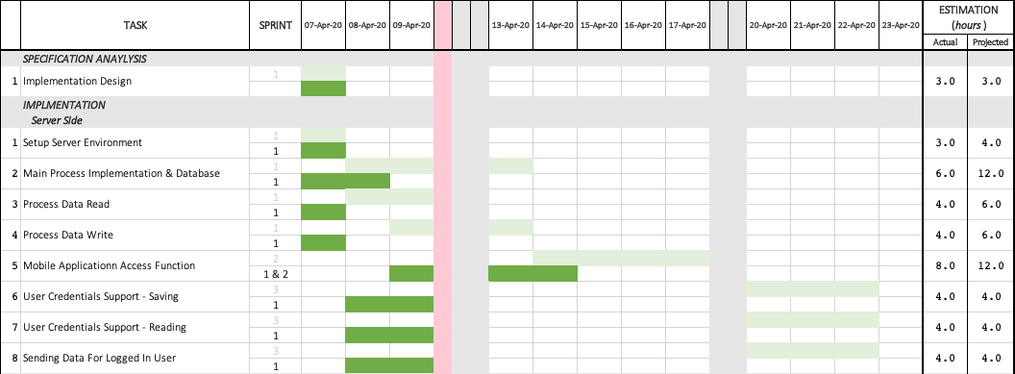
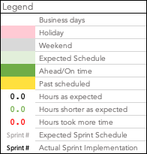
Timeline Actual Dates and Estimation

Slide 18
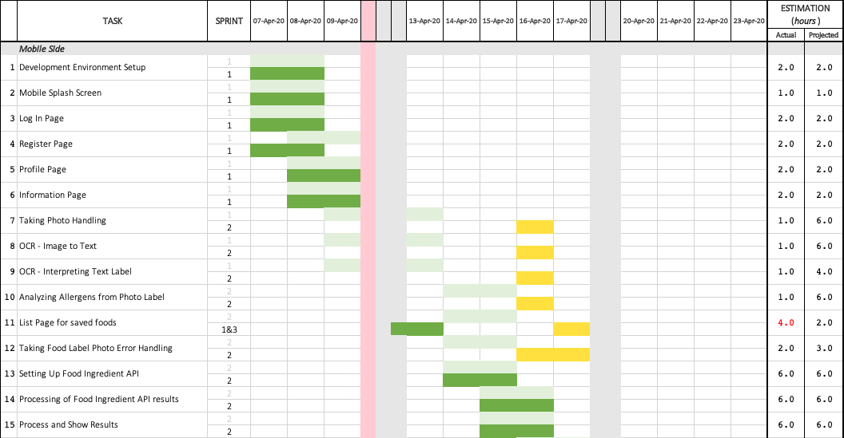
Timeline Actual Dates and Estimation

Slide 19
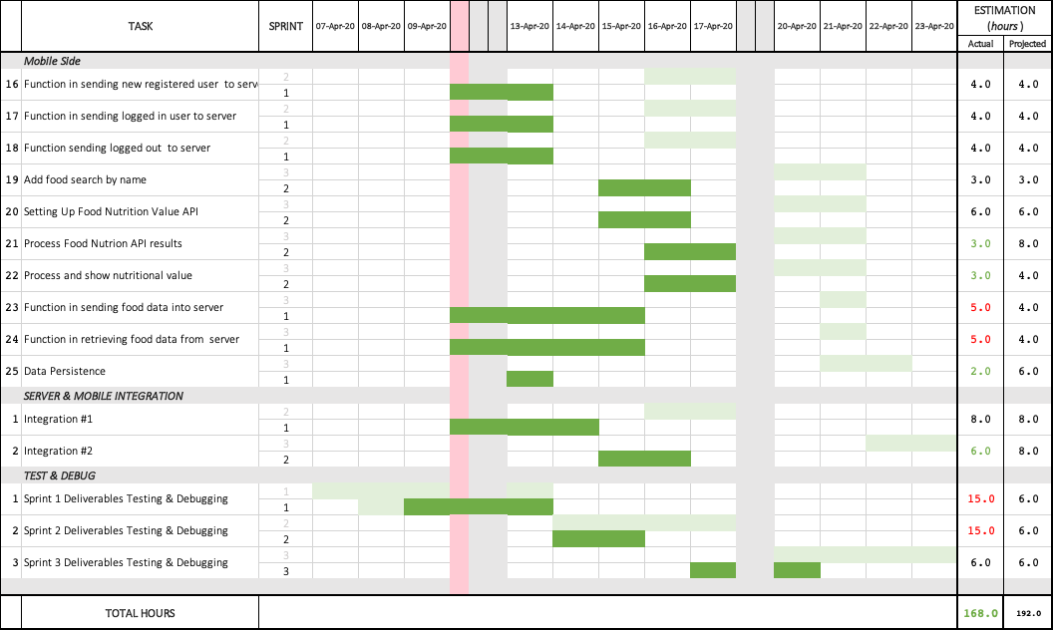
Timeline Actual Dates and Estimation

Slide 20
Project Results Analysis Specification VS Implementation
IngSpector Mobile Application is developed as expected as planned in Specification Phase.
Although there were changes in schedule, project is submitted on time, tested, and with quality.

Slide 21
Test Results Based on Acceptance Procedure

Slide 22
Test Results Based on Acceptance Procedure

Slide 23
Test Results Based on Acceptance Procedure

Slide 24
Test Results Based on Acceptance Procedure

Slide 25
Project Results Learnings
Development Skills
Team Work
Time Management
Software Development Life Cycle

Slide 26
Project Results Conclusion
IngSpector Development
Room For Improvement
Limitations
Business Probability

Slide 27
Teamwork
Development is using Agile Scrum and has Scrum board will all broken down tasks
Git-Scrum Link

Slide 28
IngSpector DEMO

Slide 29
IngSpector Testimonials

Slide 30
Thank You
“Live Long & Prosper”

